Slide 1

Operating Systems
BCSC 0004
Introduction to Operating Systems

Slide 2
Operating System
“A program that acts as an intermediary between a user of a computer and computer hardware”
“Operating system controls and coordinates the use of the hardware among various applications programs for various users”
“The operating system is the one program that is running all times on the computer (usually called the Kernel), with all else being application program.

Slide 3
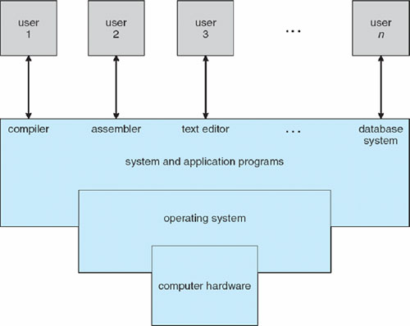
Component of Computer System

Slide 4
Operating System
Primary Goal: Convenience of use (For small PCs)
Secondary Goal: Efficient utilization of Resources i.e h/w and s/w (for large, shared and multiuser systems).

Slide 5
Bootstrapping
Booting is the process of loading operating system into main memory.
For a computer to start running, it needs to have an initial program to load and execute the boot program, which in turn loads the operating system.
The primitive loader program that can load and execute the Boot program is called Bootstrap Program.
Boot strap program is generally stored in ROM.
On- Start up, the computer automatically reads the bootstrap program.

Slide 6
Uses of Operating System
As a Government: Like a government, the OS perform no useful function for itself. It simply provides an environment within which other program can do useful work.
As a resource Manager: The OS acts a manager of the computer system resources (like software and hardware and more specifically CPU time, memory space, file storage space, I/O devices etc) and allot them to specific program and uses as necessary for their tasks.
As a Control Program: The Operating system controls the execution of user programs to prevent error and improper use of the computer. It is especially concerned with the operation and control of I/O devices

Slide 7
Simple Batch Systems ( Resident Monitor)
The emphasis was on high utilization of computers to get as much as they could from their investments.
Professional computer operators were hired which has reduced the job set up time.
Jobs with similar needs were batched together and run through the computer as group.
Automatic job sequencing was developed for automatically transferring control from one job to the next.
A small program called a resident monitor was created for this purpose. It was always resident in the memory

Slide 8
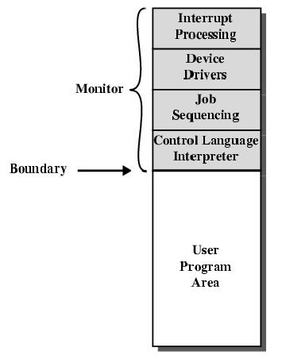
Resident Monitor
The resident monitor would automatically sequence from one program to another and from job to another.
Control card interpreter was responsible for reading and carrying out the instruction on the cards at the point of execution.
The delay between job submission and job completion is called TURNAROUND time, may result the amount of computing needed or from delays before the OS starts to process the job.

Slide 9
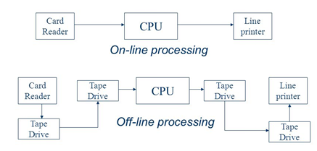
OVERLAPPED CPU and I/O
Even with automatic job sequencing, the CPU is often idle. The problem is the speed of the mechanical I/O devices which are intrinsically slower than electronic devices.

Slide 10
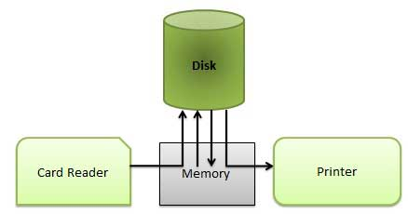
Spooling ( Simultaneous Peripheral Operation On-Line)
Random-Access Device like disk system was introduction.
Location of card images is recorded in a table kept by the operating system.
When the job is completed, the output is actually printed.
This form of processing is called Spooling.

Slide 11
Spooling ( Simultaneous Peripheral Operation On-Line)
Spooling overlaps the I/O of one job with the computation of other jobs.
Spooling has a direct beneficial effect on the performance of the system
Spooling can keep the CPU and the I/O devices working at same time at much higher rates.

Slide 12
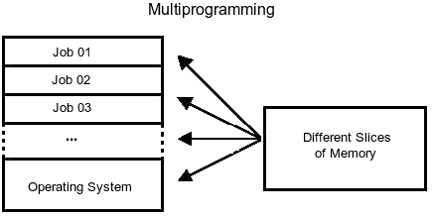
MULTIPROGRAMMED BATCH SYSTEMS
Multiprogramming increases CPU utilization by organizing jobs so that the CPU always has something to execute.
The OS picks and begins to execute one of the jobs in the memory.
The OS switches to and executes another jobs, when one job needs to wait for some I/O operation.
As long as there is always some jobs to execute, the CPU utilization increases.

Slide 13
MULTIPROGRAMMED BATCH SYSTEMS
If several jobs are ready to be brought into memory This decision is job scheduling. [ Long Term Scheduler]
In addition if several jobs are ready to run at the same time, the system must choose among them. This decision is CPU Scheduling. [ Short Term Scheduler]

